Slide 1


Reading Report 5
Streaming Hierarchical Clustering for Concept Mining

Slide 2
Introduction
Concept Mining:
Extracts meaningful associations from large, unstructured data streams
Problem Statement:
Existing systems struggle with real-time clustering for vast data, especially in bioinformatics and network analysis
Streaming Hierarchical Clustering:
Enables dynamic, real-time document organization into a hierarchy
Key Innovation:
Hardware-compatible, handles high data ingestion rates without needing pre-trained models, making it ideal for intelligence and evolving data streams

Slide 3
Key Approach
Hierarchical Clustering:
Automatically organizes incoming data into a multi-level structure, capturing relationships between documents as they are processed in real time
This method enables a continuously evolving, flexible document hierarchy
Real-time Adaptation:
The system dynamically adjusts clusters as new data arrives, effectively managing concept drift by reshuffling and reorganizing clusters to reflect the most current associations in the data stream
Hardware Efficiency:
Leverages specialized hardware, such as Xeon processors and FPGA implementations, to process high data ingestion rates while maintaining computational efficiency
This approach ensures low-latency clustering, even with large datasets

Slide 4
Hierarchical Partitioning
Dynamic Partitioning
The method organizes data into hierarchical partitions based on similarity, uncovering patterns at various granularity levels
Adaptive Reconstruction
Clusters continuously adjust as new data arrives, keeping the hierarchy up-to-date, essential for fast-paced environments
Scalability
Built to efficiently manage large datasets, this approach supports applications in social media and real-time network monitoring without sacrificing performance

Slide 5
Experimental Results
K-means Clustering
Groups data into K clusters, minimizing intra-cluster distance
Uses distance metrics like Minkowski, Manhattan, Euclidean, and Cosine theta
Algorithm Steps
Assign documents to K groups
Calculate centroids
Update assignments until stable
Bisection K-means
Splits clusters iteratively until reaching the desired number
Confusion matrices show k-means underperformance compared to hierarchical methods

Slide 6
Hardware Design
FPGA Implementation
Optimized for integer arithmetic to boost parallelism and avoid precision loss
Performance Optimization
Bitmap packing reduces memory bandwidth and enhancements for vector summation and dot product tasks yield up to eightfold speedup
Future Enhancements
Potential for up to 45 times faster performance using 64-bit instructions and signal processing extensions

Slide 7
Streaming Hierarchical Partitioning
Overview
Adapt hierarchical partitioning for evolving document streams
Assumptions
Limited memory (m documents) and processing capacity
New document requires removal of an existing one
Clustering Strategy
Recluster every tt time-steps
Efficient insertion/removal using cosine similarity and greedy matching

Slide 8
Streaming Experimental Results
Setup
Newsgroup data streamed to simulate concept drift
Parameters
Max memory: 1000 documents
Reclustering: After processing 1000 documents
Evaluation Metrics
Purity Score: % of documents in pure clusters
Discovery Score: Counts unique label clusters over time
Results Comparison
Non-naive method outperforms naïve in concept discovery while maintaining purity

Slide 9
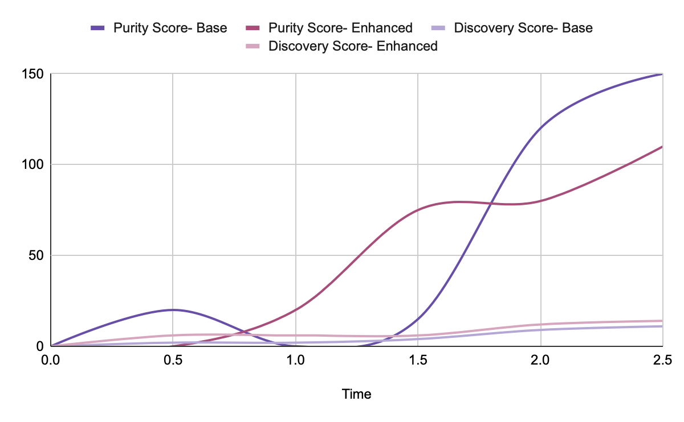
Streaming Experimental Results

Slide 10
Quiz Question
Question: What is a primary attribute of Streaming Hierarchical Partitioning when used for document clustering?
Answer:
Streaming Hierarchical Partitioning does not store an infinite number of documents in memory. Instead, it uses cosine similarity to efficiently insert documents and requires the removal of existing documents to make space for new ones. This approach does not perform clustering only once at the end of the document stream; rather, it continuously updates the clusters as new documents arrive. Additionally, it does not rely on traditional k-means clustering without adaptations; it is designed to handle streaming data effectively.

